Slide 1
Implementation of Data Mining Techniques in Breast-Cancer by WEKA TOOL
Presented By:
Md. Ashikuzzaman(2015-1-60-035)
Md. Ishtiak Harun Shovon(2015-1-60-122)
Md. Fahim Talha (2014-3-60-004)
Md. Shahrier Sarder Shoumik (2015-1-60-081)

Slide 2
Over View
Introduction
Algorithm
Procedure
Flow Of Data
Accuracy
Curve

Slide 3
Introduction
◆ Data Mining is branch of Data Science which incorporates a large set of statistical techniques.
◆ We use Weka tool
◆ We take a data set of breast cancer from kaggle.com

Slide 4
Breast Cancer
◆ The most common cancer in women worldwide.
◆ The principle cause of death from cancer among women globally.
◆ Early detection is the most effective way to reduce breast cancer deaths.
◆ Early diagnosis requires an accurate and reliable procedure to distinguish between benign breast tumors from malignant ones
◆ Breast Cancer Types - three types of breast tumors: Benign breast tumors, In-situ cancers, and Invasive
cancers.

Slide 5
Algorithm Name
Naïve Bayes
Random Forest
Logistic Regression
Decision Tree

Slide 6



Procedure
Input Files
Lab Setup
RandomForestClassifier
Naïve Bayes Logistics Reg. Decision Tree
breast-cancer
.data
Data Preparation
Outputs
Algorithm
Trained Classifier
Classification,Testing,Training, validation
Predictions
Weka
Environment
windows

Slide 7




















Flow of Data
Take Data set
Classification
Apply Algorithm
Measurement
Analysis
Choose Algorithm Type
Predictions and
Divide into Classes
validation

Slide 8
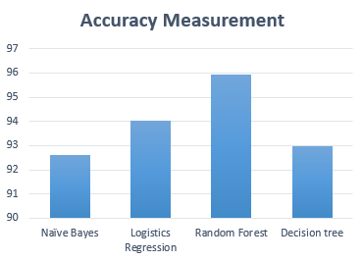
Accuracy
1)

Slide 9
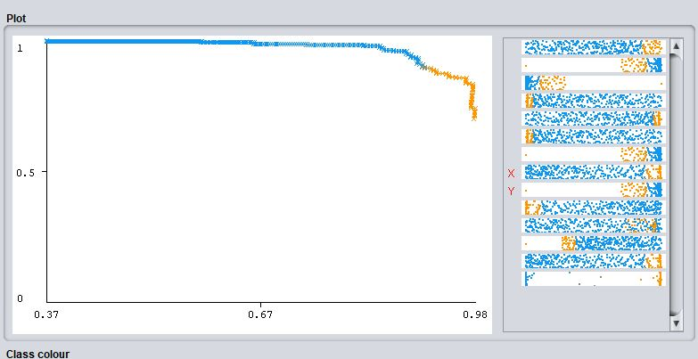
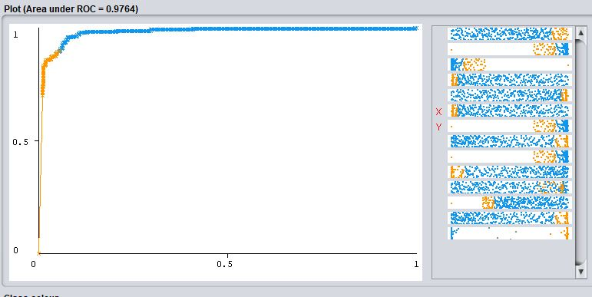
Naïve Bayes Precision-Recall
Naïve Bayes ROC
1)

Slide 10
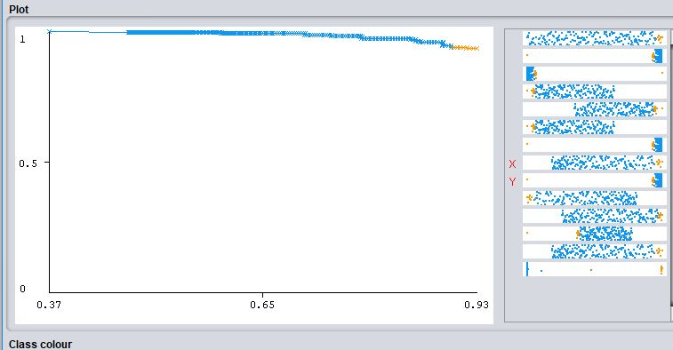
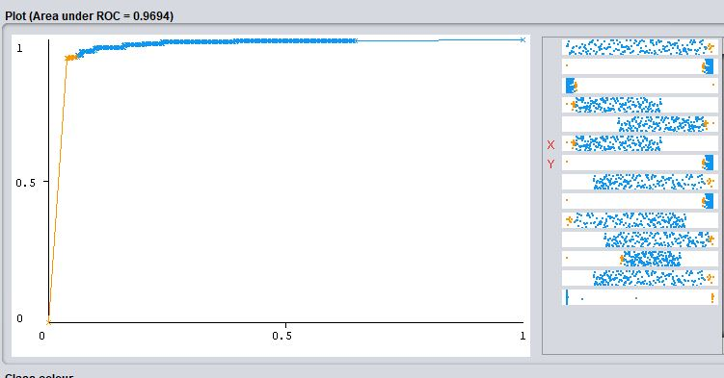
Logistic Regression Precision-Recall
Logistic Regression ROC

Slide 11
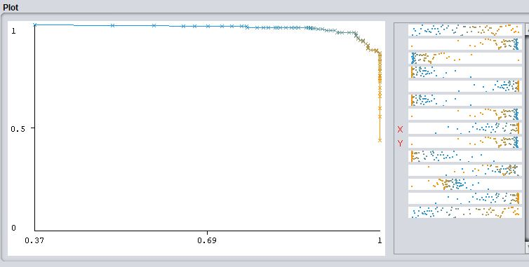
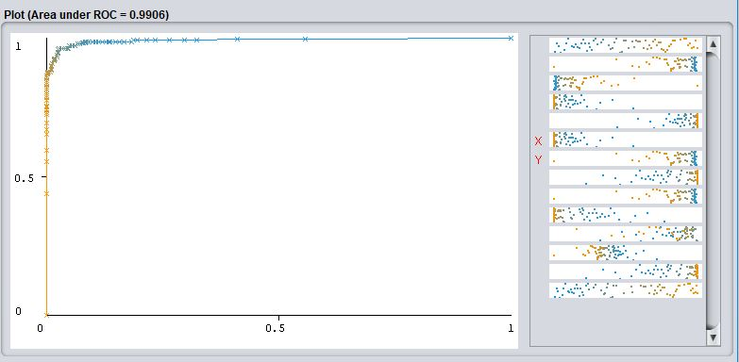
Random Forest Precision-Recall
Random Forest ROC

Slide 12
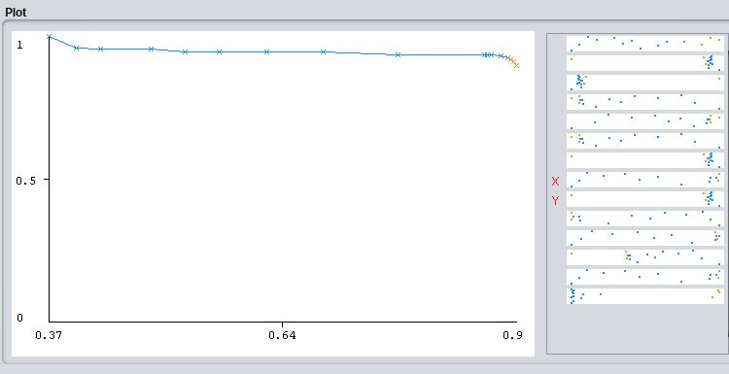
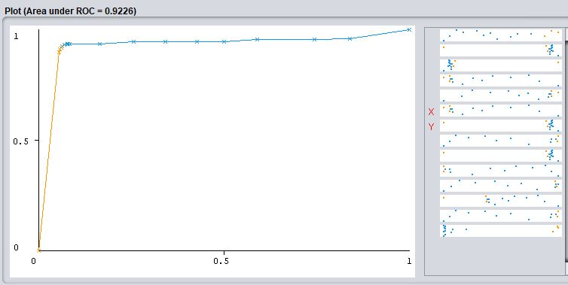
Decision Tree Recall-Precision
Decision Tree Forest ROC

Slide 13
Any Question Or Suggestion???
Thank You

